Slide 1
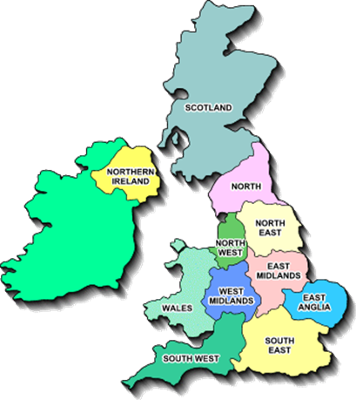
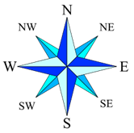
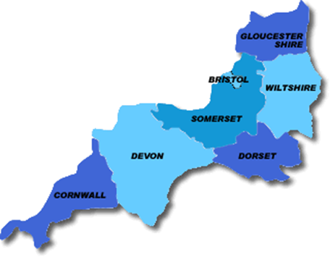
Come with us down to the beautiful West Country, to explore the counties of the South-West of England.
Remember, you can use the compass to see which way we are travelling.

Slide 2
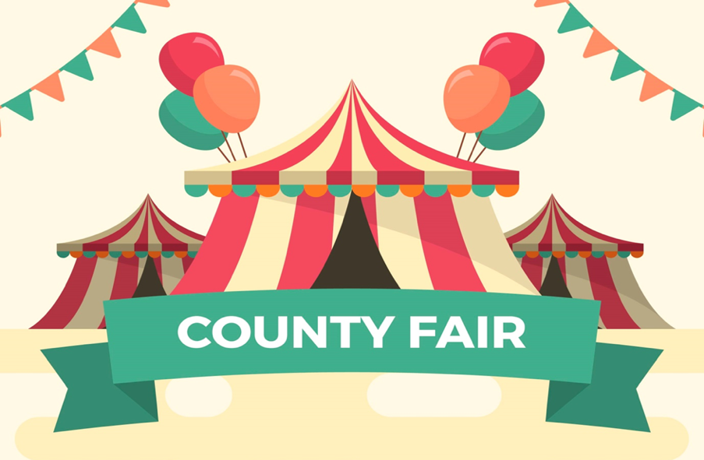
Welcome to Devon!

Slide 3
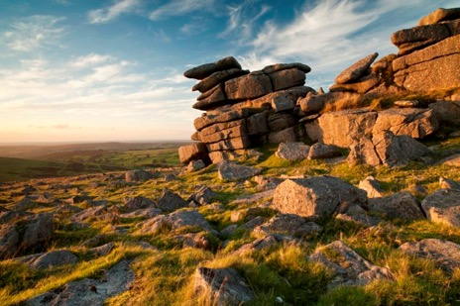
Exmoor and Dartmoor have both been National Parks since the 1950s. They each have some of the last real wilderness areas of England, each home to many different habitats, mysterious stone outcrops, hidden valleys and wonderful wildlife.
Look in the resources section on the website for the habitat posters of Exmoor. Choose a habitat, then:
make observational drawings of the flora or fauna.
make a collage
use crayons to make a resist picture of the stones, using wax crayons for the stones, then a watercolour wash over the top for the wide sky
Explore the habitats nearer to home, making a collection of pressed leaves and flowers.

Slide 4
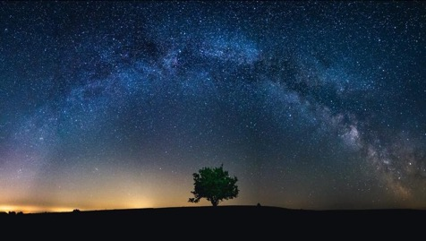
* Follow this link for an explanation of constellations – patterns of stars in the sky, then try making some of them in different ways… https://www.youtube.com/watch?v=1sZ15SUeS9w * Look in the resources section, where you will find four constellations to get you started, though you can make as many as you can find out about. Try making them outside using natural materials (sticks, stones, clover, daisies…) * Using the constellation pictures as a guide, punch out the stars of a constellation on a piece of card. Hold the card up against a wall and shine a torch at it – see the constellation appear! Where can you get the best results?
Exmoor hosts an annual Dark Skies Festival – the first one was held here to celebrate Exmoor being given the status of Europe’s first International Dark Sky Reserve. As so much of Exmoor is wild, uninhabited land, it is the perfect place to enjoy stargazing, as there is hardly any light pollution to limit your view of the night sky.
Constellations often tell a story – devise a new constellation, mark it out on dark paper and then add a caption to explain the story behind it.

Slide 5
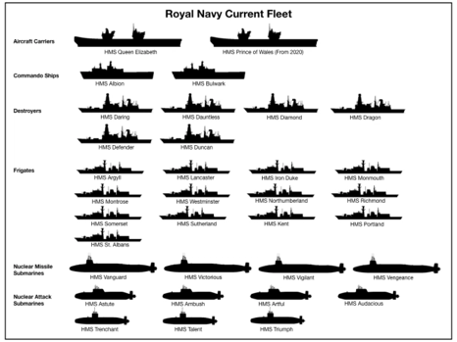
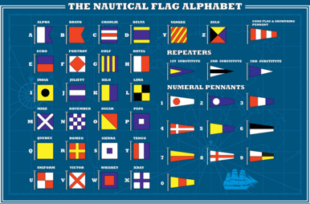
Seafarers all…Plymouth has been an important port for hundreds of years. In 1390, a law was passed that declared that all pilgrims must sail from either Plymouth or Dover. The famous defeat of the Spanish Armada took place off the coast at Plymouth, and in September it will be 400 years since the Pilgrim Fathers set sail from Plymouth in The Mayflower, for the Americas.
There has been a Navy base at Plymouth since 1691, and today HMNB Devonport is the largest naval base in Europe.
Make an authentic Battleships game, making a game card of vessels based at Plymouth.
Make a flotilla of paper boats.
Make other sea vessels: a Moana inspired Polynesian raft, a dug-out canoe, a coracle.
Explore the International Nautical Flag Alphabet and draw out a message on flags!

Slide 6
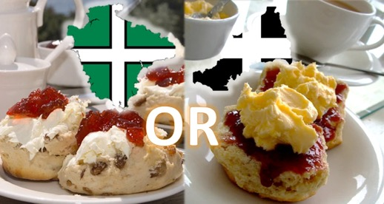
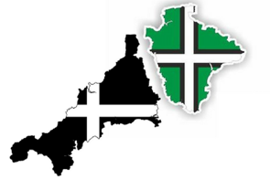
Both Devon and Cornwall are famous for their delicious cream teas, which may seem the same, but the locals are very particular about how they take them: in Devon, the cream goes on first, whereas in Cornwall, the jam goes on first. How do you take yours?
Why not try hosting a very English afternoon tea? Start finding out what might be on the menu – scones, cucumber sandwiches…
Does any-one you know have a favourite scone recipe? See if there is a family recipe that you could try out, or look on the BBC food website.
When you have decided on the menu, write it out, decorating it nicely.
How will you set the scene and make the table look inviting? You could make pretty paper place mats or a table runner, put out flowers or maybe bunting!
You could decorate your table to match how you take your scones! Above you can see the county flags for Cornwall and Devon.

