Slide 1
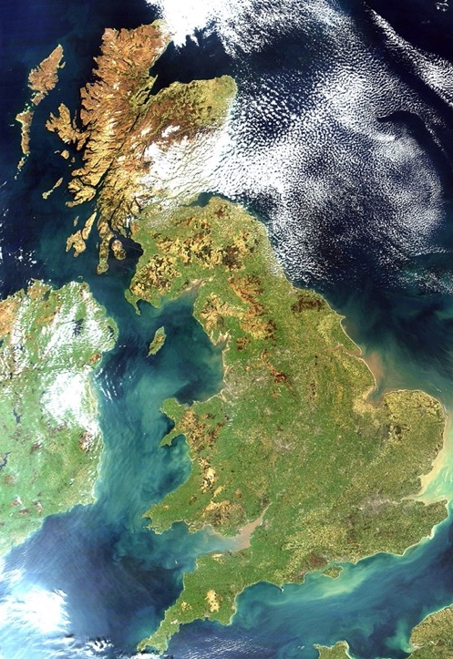
Fairway Primary Academy, Muirfield Gardens, Kings Norton, Birmingham, West Midlands, England, Great Britain, The United Kingdom, The British Isles, Europe, Planet Earth…
Can you explain the differences between the names in green?

Slide 2
When we use maps we are looking at representations of the physical world and the political world. Great Britain is the name of the largest island in the British Isles and the very small islands that fringe it. The United Kingdom is the name for the four countries that are broadly linked with some common government.

Slide 3
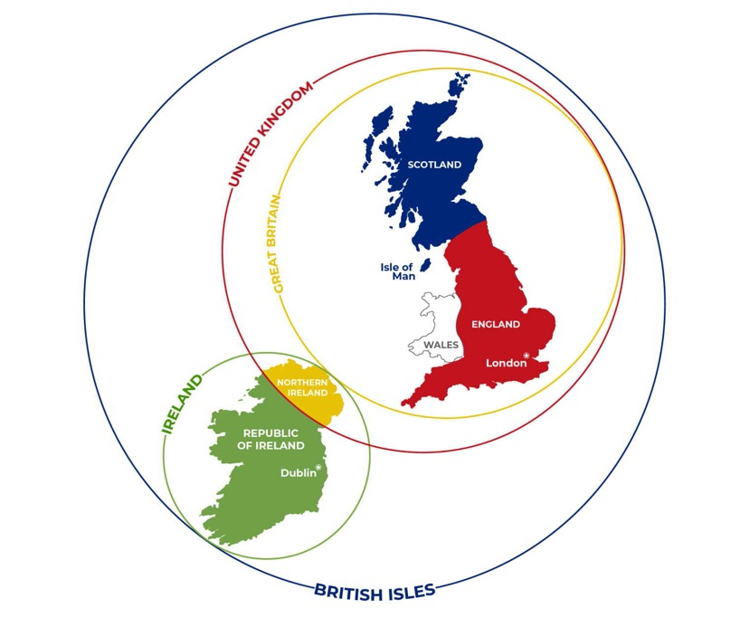
The British Isles includes all the islands in this chain.
Now have a go at explaining each term again!

Slide 4
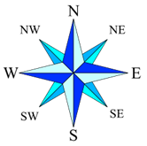
This map shows the four countries of the United Kingdom – what are the four capital cities? Here we also see England divided into its different regions. We live in the West Midlands region, which you can see in sky blue.

Slide 5
Here you can see a close up of the West Midlands region, which is made up of six counties, – though confusingly, one of the counties of the West Midlands is called the West Midlands! Birmingham, our home city, and the second city of England, is in the West Midlands.

Slide 6
Welcome to Staffordshire!

Slide 7
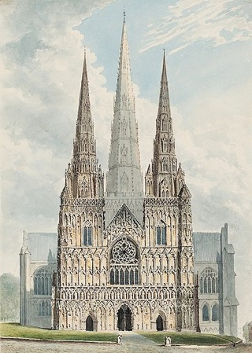
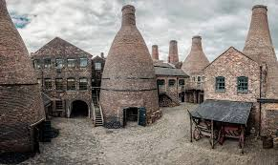
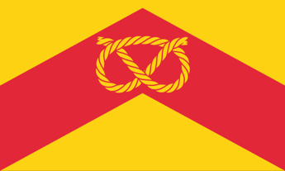
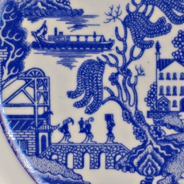

Slide 8
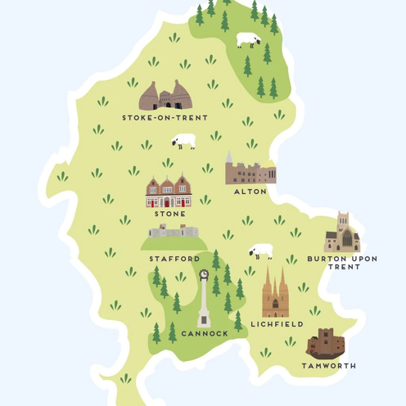
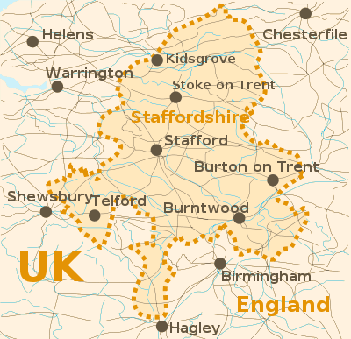
How are these maps similar? How are they different? What are they showing? Which of these places have you visited?

Slide 9
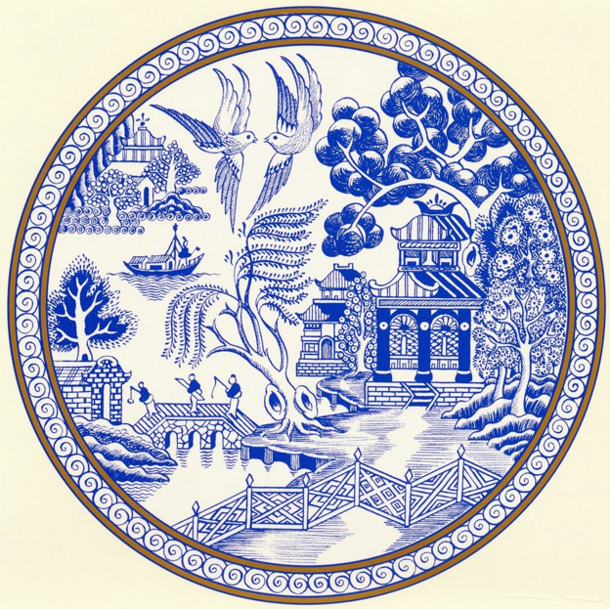
https://www.youtube.com/watch?v=4VwAYc7dsUE Click to hear the story of the most famous famous of china designs – the Willow pattern.
Staffordshire is of course world famous for its potteries.

Slide 10
In this version of the Willow pattern, it has been adapted to reflect the local industries of Stoke-on-Trent. The temples have been turned into bottle ovens and pithead winding gear. The boat has become a canal barge, the fence a steam train and the birds have become Spitfire planes. The three figures carry a miner’s pick, a pot and a saggar.

Slide 11
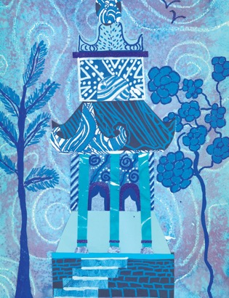
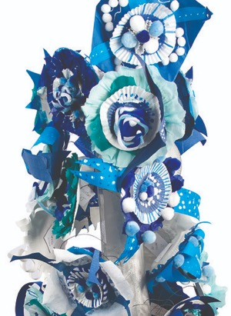
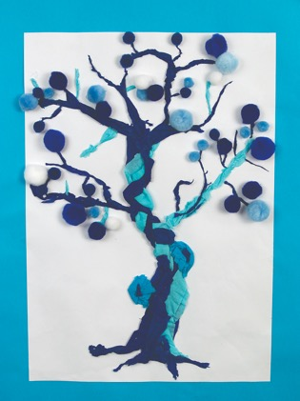
Try creating a monochromatic design – that is one that is just in one colour. You could use different shades of blue, or try a new colour. Experiment with drawing some designs based around the Willow pattern. Decide on the medium you will use – why not try a mixed media piece with collage, pen, paint and chalks? You could even make a 3D Willow inspired tree as a collaborative piece!

